Slide 1
Building a Compassionate Staff Culture
Liz Krubsack, MS, LPC
Molly Herrmann, MS
Student Services/Prevention & Wellness
10/12/20

Slide 2
What is Compassion Resilience?
The power to return to a position of empathy, strength, and hope after the daily witnessing of the challenges families face in our community and the realities of the workplace.
To be optimistic in an imperfect world.
Notes:
MOLLY
Good morning! I am excited to be able to share with you a bit about the Compassion Resilience Toolkit developed by Rogers In Health with assistance from the Department of Public Instruction. Before I go any farther, I would like to give credit to Sue Dicks at Rogers and Monica Caldwell at RISE (formerly at DPI) for the development of the toolkit. The toolkit was first piloted in schools and non profits in 16-17. Launched 17-18.
I was lucky enough to pick up the Compassion Resilience tool kit post pilot and launch.
Popularity during covid
Free
Flexible
Preview of session
Lets ground ourselves in how we are focusing our efforts to accomplish with this work.
When we think about this idea of resilience in terms of educators, we’re really talking about educators having the ability to use their energy in a productive way, that achieves school goals and meets student needs, even in the face of adversity. .
Compassion resilience for those in the education field looks like:
Being physically, emotionally, and mentally well AND compassionately identifying and addressing the
stressors that are barriers to learning for students,
Identifying and addressing the barriers to caregivers/ parents and colleagues being able to effectively partner on behalf of children, rather than blaming or shaming
Think of this resilience as a bucket of well-being that we can draw upon on difficult days and in difficult situations. This toolkit that we will be talking about in a moment will explore the protective factors that build and maintain compassion resilience, or continually refil that bucket.
Why Build Resilience?
Research indicates that resilient teachers tend to maintain job satisfaction and commitment to their profession (Brunetti, 2006).
A focus on compassion resilience will guide all staff back to the core set of values and the drive for a sense of purpose that brought them to education in the first place. Especially now during school closures, educators may be losing their ability to connect to that sense of purpose.

Slide 3
What is Compassion Fatigue?
Secondary trauma and burnout
Gradual lessening of compassion over time
Avoid trying to understand what people face
Become less effective in our roles
Life satisfaction decreases
Notes:
MOLLY
Compassion fatigue is an umbrella term for two other terms we hear a lot: burnout and secondary trauma.
Burnout refers to the exhaustion of physical or emotional strength or motivation that happens as a result of prolonged stress related to very high workload, non-supportive work environment, and/or feeling that our efforts make no difference.
Secondary Trauma (also known as secondary traumatic stress and vicarious trauma) can happen to us when we come to know the traumatically stressful events that the students we serve have experienced. Those that are in a position to hear about trauma on a regular basis are particularly susceptible.
Compassion Fatigue can be summed up as the feelings of depression, sadness, exhaustion, anxiety and irritation that may be experienced by people in their work and/or personal life.
ACTIVITY:What can it look like? Take a few moments to type into the chat box an example of what compassion fatigue might look like in practice. An example I’ll give is becoming less effective in our roles. So maybe you start feeling that you can never do enough, and so you take on more, and become less able to do these things well. Or maybe your fatigue is looking like an inability to embrace complexity. So your thinking has become black and white, and you’re not able to recognize the nuance that’s involved in meeting the challenges of your work.
Gradual lessening of compassion over time
Avoid trying to understand what people face
Life satisfaction decreases
The pandemic we are experiencing presents the perfect storm for compassion fatigue. With increased personal and professional demands and less access to typical supports, many are experiencing this fatigue.

Slide 4
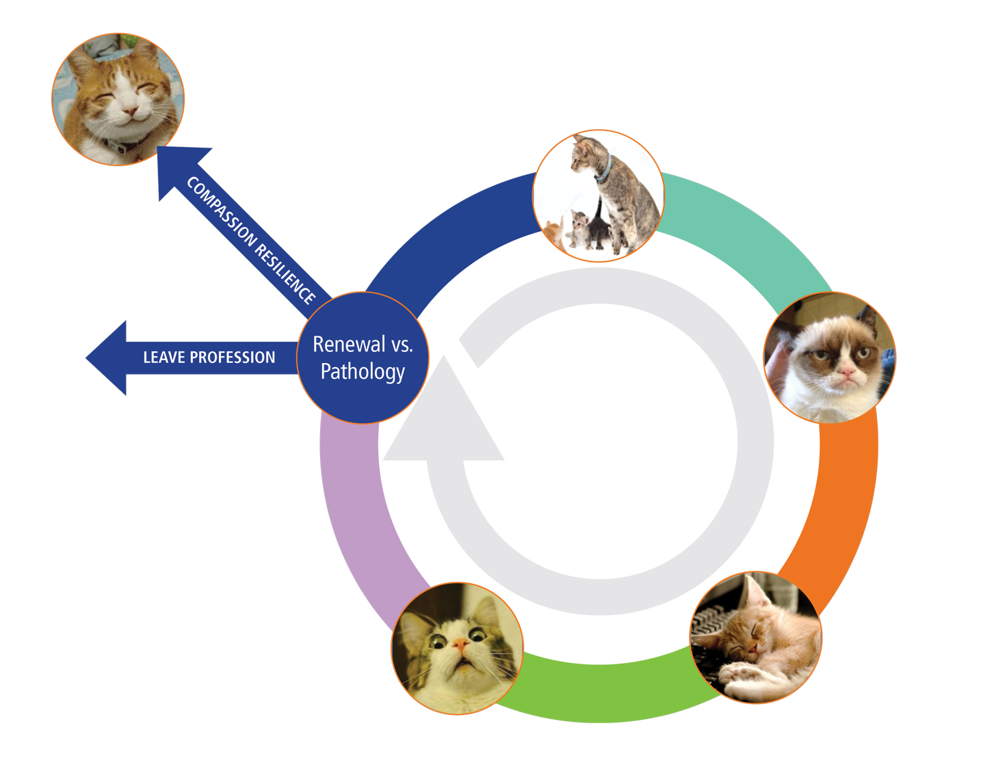
Stages of Fatigue
ZEALOT
RENEWAL vs. PATHOLOGY
IRRITABILITY
ZOMBIE
WITHDRAWAL
Notes:
MOLLY
We do not want to dwell too long on compassion fatigue, yet it is important to acknowledge and validate that what you might be feeling right now is a normal reaction to a complex and overwhelming circumstance that compounds the usual sources of fatigue we already may have been experiencing.
First, in the Zealot stage, we have an over-abundance of “can do” activity. We are committed, involved, and available, ready to problem solve and to make a difference. We are willing to go the extra mile.
Along the way, however, we start to notice that the things around us aren’t perfect, that systems we’re part of may not function the way we want them to, and move into the Irritability stage. We may feel anger and cynicism, diminished creativity, sadness, feeling helpless or hopeless. We move from “can do” to a sense of frustration and cynicism. Our hopefulness starts to wane.
This can be overwhelming and lead us to the natural reaction of Withdrawal. We may be overwhelmed by complexity, chronic exhaustion, physical illness, difficulty empathizing, feeling numb to other’s pain, absenteeism.
The Zombie stage is when we put up walls by shedding connections to avoid facing the imperfections and complexities and “go it alone.” A sense that you can’t ever do enough, inflated sense of importance, sleeplessness, sense of persecution.
Note the growing isolation as a misguided way to protect oneself from the unaddressed realities of the work, the workplace and the systems that are supposed to provide supports.
Highlight the fact that we don’t talk about these stages to shame or blame anyone, but to give us a better understanding of where we may be at so that we can take appropriate action to support our resilience.
SHaring the stages of fatigue with your staff and facilitating a discussion about it can be a good way to acknowledge what staff are experiencing right now, and find a sense of universality from the fact that they aren’t alone wherever they are with this cycle. We’ll take a few minutes now to model how this discussion could look with staff.

Slide 5
Breakouts
In small group, invite each person to:
Share: Name and role.
Answer: Which stage most resonates with you now?
Share: A brief personal or professional example of how that stage looks for you.
Notes:
Let’s break it up a bit and have you talk to each other about compassion fatigue and those cat faces. In your breakout group, share your name and role, what stage resonates with you most, and a brief personal or professional example of how that stage looks for you.

Slide 6
Feeling Like Compassion is Out of Reach?
Step 1: “Just like me, this person is seeking happiness in their life.”
Step 2: “Just like me, this person is trying to avoid suffering in their life.”
Step 3: “Just like me, this person has known sadness, loneliness and despair.”
Step 4: “Just like me, this person is seeking to fill their needs.”
Step 5: “Just like me, this person is learning about life.”
Notes:
LIZ
Recently, you may have had virtual interactions with colleagues, students, and families where feelings of compassion seem out of reach. Maybe it is because you are in different stages of fatigue. When this happens, you can try this 5-step activity. This is a great activity to share with your staff.
You can begin by simply bringing someone to mind, and eventually you can do this when you want to bring yourself out of a place of judgment in a tough interaction with another person.
We’ll give you a few minutes to think of a person and work through each of these five steps.
Read five steps.
Please share in the chat box a feeling or reactions you’re having to this activity - GIVE Time.
The idea here is to reinforce the idea that at the root of it all, we are all human beings that crave attention, and recognition, and affection, and above all, happiness.

Slide 7
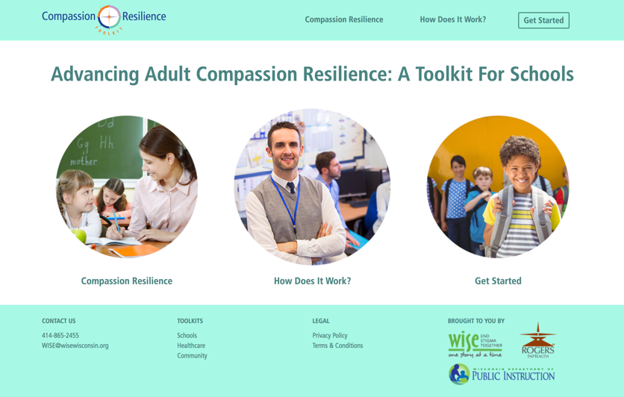
Toolkit Tour
Whole toolkit implemented over a two-year timeframe
Tier one approach
Each section can be implemented in 30 minute sessions
COVID update for immediate use
Notes:
Liz
The activity we just completed is an example of the types of activities you will find in the compassion resilience toolkit.
Is one way for schools to support staff resilience, particularly during this difficult time. It is not only focused on individual resilience, but building a compassionate staff culture.
The toolkit offers information, activities, and resources for school leadership and staff to understand, recognize, and minimize the experience of compassion fatigue and to increase compassion resilience perspectives and skills.
It will do so by helping participants develop skills to manage expectations, set professional and personal boundaries, build effective collegial relationships, and practice real-time and ongoing self-care.
A NOTE: Teachers aren’t the only ones who benefit from a focus on resilience. Principals, administrators, superintendents, student services staff, coaches, para-professionals, and others who form the school community contribute to the decisive elements that influence a school that is thriving.
The toolkit has two other sections, one for health and human services workers, and one for parents.
While we will be primarily focusing on the educator toolkit today, the recently released parent toolkit is a great new resource to share with families. Many of us are both educators and parents, so parent toolkit might be personally relevant as well.
The toolkit is designed for flexible implementation by facilitators within their school. It’s meant to bolster a universal approach to compassion resilience, and is not an intervention for staff who “need it most”
We typically recommend the toolkit be implemented over a two-year timeframe.
Each of the twelve sections can be briefly implemented in a thirty-minute session (with individual reflection and application resources) or more time can be dedicated for in-depth learning experiences.
Input from the schools that piloted the toolkit included a strong suggestion that the implementation plans include a process that provides safe places for “real talk” among staff about toolkit concepts. Small group staff conversations and a plan for two-way communication between the staff groups and administrative team are key strategies for implementation. A team of leaders and the appointed facilitator(s) will need to make decisions about the time that the administrative team and staff will dedicate to the toolkit activities and topics that might be a higher priority. With that direction, the facilitator selects activities to match the needs, characteristics, and dedicated focus of the group.

Slide 8
Toolkit Outline
Sections 1-3
Sections 4-7
Sections 8-12
Creating a shared understanding of compassion, fatigue, and resilience
System and team-level strategies
Individual approach to building self-care skills
Notes:
LIZ
The Toolkit contains 12 different content sections, including:
Compassion in Action
Wellness, Compassion Fatigue, Self-Compassion, Compassion Resilience
Compassion Fatigue Awareness, Connection to Trauma, and Assessment
Systemic Drivers of Compassion Fatigue
Expectations from Self and Others
Compassionate Boundary Setting
Contract for Positive Staff Culture
8-11. Self-Care Strategies – Mind, Spirit, Strength and Heart
12. Compassionate Connections with Care Givers
Appendix
Making and supporting change
Foundational Beliefs about Behavior
Compassionate response to colleagues pain
Stress throughout the Career Cycle

Slide 9
Toolkit Elements
Notes:
LIZ
Each of the toolkit sections contains a few different elements:
Introduction: provides a paragraph summary of content in the toolkit.
Information: Delves more deeply into the concepts presented in each section of the toolkit. Information is presented in various formats such as narrative, slides, links to videos, etc. The information can be shared with staff individually through email or handouts or to a small or large group of staff in presentation style by a school leader or the toolkit facilitator.
Self-care strategies: Rather than wait until later sections of the toolkit to encounter strategies for self-care that support compassion resilience, each section offers an activity related to the wellness compass. Experience the benefits of these strategies and prepare for the four sections that explore them more fully.
What’s next: Introduces the next section of the toolkit. Offer activities to engage individuals, small groups or whole staff in making the content relevant to their experience in your school community. Activities are targeted towards either school leadership or staff.
Applications: Internet links that are woven into the content are pulled out and listed for easy access.
Links to other related resources are also listed.

Slide 10
COVID Toolkit Supplement
Notes:
LIZ
The COVID-19 supplement touches on 9 different areas from the toolkit that have been identified as particularly useful during this time. Each topic contains a video that discusses the concept as it relates to our current experience, and an example of an activity you could do to help build resilience and bolster that skill area. It also includes a write-up of similar information.
So even if no one in your district feels ready to facilitate the full toolkit, these are really simple entry points for building adult compassion resilience RIGHT NOW. You could send out the videos or blog posts each week or month to your staff, with a few questions or points to think about. This way, you can get folks working on these resilience skills now without overwhelming with full toolkit implementation. We’ve heard from a few districts that they’ve had success with this approach.

Slide 11
COVID Toolkit Example Virtual Session
Example Agenda: Locus of Control
Activity | Location | Time
Rogers Locus of control video introduction, activity introduction | COVID Toolkit | 7 minutes
Drivers of Fatigue and resilience activity and processing | COVID Toolkit | 10 minutes
Putting it into practice discussion | Educator Toolkit, Section 4, Staff Circle agenda | 8 minutes
Notes:
MOLLY
Here’s an example of one of the strategies included in the COVID toolkit. It includes the information in the COVID update, along with an example activity from the corresponding section of the toolkit. Many of the toolkit activities could easily be adapted to a virtual setting.
Talk about how we have done this virtually.

Slide 12
Locus of Control:
Fatigue and Resilience Exercise
Notes:
MOLLY
The linked tool includes a video of Sue leading this exercise, than you can use to share this exercise with others.
Small group-
For this exercise, you will need a piece of paper and a writing utensil (or just pull up a word doc on your computer). Start by focusing on one aspect of your life, either that has drastically changed recently, or about which you are feeling a sense of stress or fatigue. Perhaps it is working from home. Or having your children home with you. It might be your fear of COVID-19 or your fear for your loved ones. Or maybe it’s the stress of trying to support students virtually.
Once you have chosen something, make two lists. On the first, list what about this time is leading to your fatigue, worry, or fear. On the second, list what about this time is feeding your resilience. For example, if you recently found yourself working from home, on the first list you might note that you are distracted by your new environment, feel a lack of structure, and miss interacting with your colleagues. On the other list, you might relish sleeping in longer, avoiding your commute, and taking mini-breaks to play with your dog. There are no silly responses!
It may be more challenging to list that which is maintaining your resilience. If so, perhaps go about your day and come back to this list later. When you’re satisfied with both lists, underline those responses where you feel you have some control. Cross out those responses where you do not have control.
Once you have completed both lists and identified the things around which you have control, consider what you would like to do in the coming days about anything you listed as under your control.
1. (Popcorn) What percentage of time does your team or sub-set spend discussing the things they cannot control when they are together?
2. (Popcorn) What percentage seems healthy for your team?
3. (Popcorn) How can you identify to your team members when the group has gone over that percentage?
Main ideas:
We can choose to focus mindfully on the experiences that increase our resilience, be intentionally grateful for these positive facets of our lives, or seek to increase or maximize these aspects of our day.
Relatedly, those aspects on both lists that are outside our control, we might attune to less frequently, talk about with others less often, or choose to ‘let go of.’ It is likely that there are some aspects of our life that we find fatiguing, around which we have control and can therefore change.
For instance, if I find my new work routine and lack of structure fatiguing, I can create a daily schedule/routine/ process for myself.
Amidst uncertainty and a disruption of life as we know it, intentionally engaging with our lives beyond COVID-19 and focusing on that which is within our control, will help us regain some of our power over our own (socially distanced) lives.
If this is an activity that you’re interested in facilitating with your staff, we recommend that you be a participant in the activity rather than the facilitator to maximize staff willingness to engage. Also, be cognizant of the power differential between you and staff and the ways that your participation in this activity could either prompt more sharing or shut down participants. Approach it with openness and curiosity.

Slide 13
Implementation Support
2-3 hour toolkit overviews to assess readiness
7-8 hour training for a team of facilitators
Email: wise@wisewisconsin.org
Notes:
LIZ
The team should include at least one administrator and 2-3 staff who will facilitate the use of the toolkit resources by leaders and staff.
Link leads to toolkit page with more information on implementation supports
We do have a virtual training of facilitators coming up, there may be some room.

Slide 14
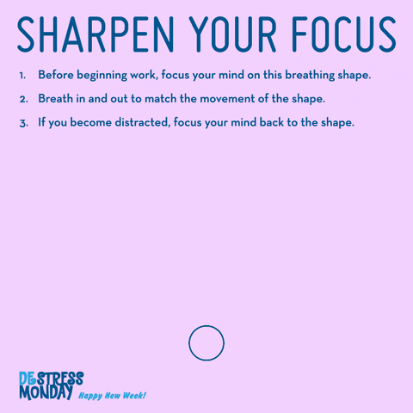
Before you go...
Notes:
LIZ
Before we sign off, let’s take a minute to prepare ourselves for whatever is next.

